Slide 1




Beyond Engagement: Evidence-Based Strategies for Improving Learning Online
Rebecca Griffiths, Digital Promise Nov 12, 2025
Notes:
Welcome.
Today we have a special preview of a new instructional model for supporting students with self-directed learning skills. We are going to take you through the model at a high level, this is not a training per se, and give you enough information so you can hit the ground running if you choose to try out the strategies we’ll describe. The model is in the final phases of editing, but we have a draft version for you to view.

Slide 2
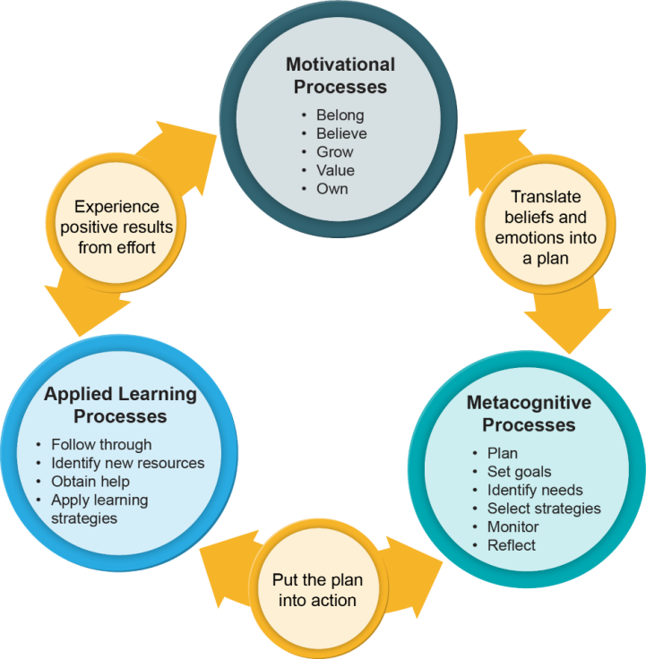



Today we will:
Share a brief
overview of the Collaborative & our self-directed learning (SDL) framework
Introduce the SDL Instructional Model and share concrete resources to guide implementation
Describe initial research findings, including instructor and student perceptions
Discuss takeaways and next steps for implementation
Notes:
Agenda:
Introductions: 5 min
Collab and framework: 5 min
SDL model overview: 8 min
Deep dive: 5 min
Research findings: 5 (plus video)
Discussion: 15
Closing 2

Slide 3
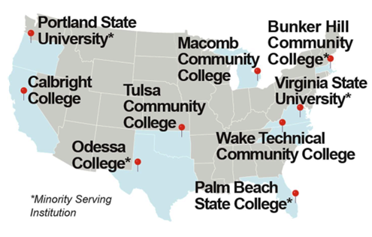

What is the Collaborative?
An Institute of Education Sciences (IES)-funded research and capacity-building center that aims to study and improve how faculty teach and use technology to help students apply and strengthen self-directed learning in online STEM courses.
Notes:
While I am introducing the Collaborative, we’d love to hear who is in the room. Please drop your name, role (faculty, administrative, etc.) in the chat.
The Collaborative is a research and capacity-building center funded by the U.S. Department of Education's Institute for Education Sciences, that aims to study and improve how faculty teach and use technology to help students apply and strengthen self-directed learning skills to increase their success in online STEM courses.
It is a partnership between SRI Education, the Community College Research Center, Achieving the Dream, and nine broad-access institutions.

Slide 4
Why focus on self-directed learning (SDL) in online courses?

Slide 5



Online learning challenges
Student outcomes are generally worse in online courses and degree programs than in comparable face-to-face ones
Less engagement and interaction in online environments
Key factors: Greater demands on students’ self-directed learning capacities; need for belonging and community
(e.g., Altindag et al., 2021; Brown et al., 2024; Xu & Jaggars, 2014;Yarnall et al., 2023)
Notes:
College students show high interest in online courses, with half taking at least one course online​. Several studies have shown that student academic outcomes are usually low in online courses compared to in-person courses (and achievement gaps are wider between student groups). Online courses put greater demands on students' self-directed learning capacities because they often have to learn more independently. In addition, it's often more difficult for students to develop a sense of belonging and community in online courses, especially asynchronous courses, and that can affect their motivation to learn.

Slide 6

Students face particular challenges in STEM learning
Environmental factors
Psychosocial factors
Individual sink-or-swim culture
Belonging uncertainty
Stereotype threat
Content-heavy courses
Feelings of isolation
Unclear personal relevance
Mismatched expectations about time commitment
(Hatfield et al., 2022; Murdock-Perriera et al., 2019; National Academies of Sciences, Engineering, and Medicine, 2025; Steele, 2010; Yarnall et al., 2023)
Notes:
Our studies focused on online introductory STEM courses, where both students and faculty express challenges. In online courses, students face both environmental factors such as an individualistic sink-or-swim culture, content-heavy courses especially in STEM, and they may not feel a clear sense of relevance to their personal lives. There are also psychological factors, including belonging uncertainty in STEM, stereotype threat, and feelings of isolation.
These issues can be especially salient for students from groups marginalized in STEM and higher education.

Slide 7
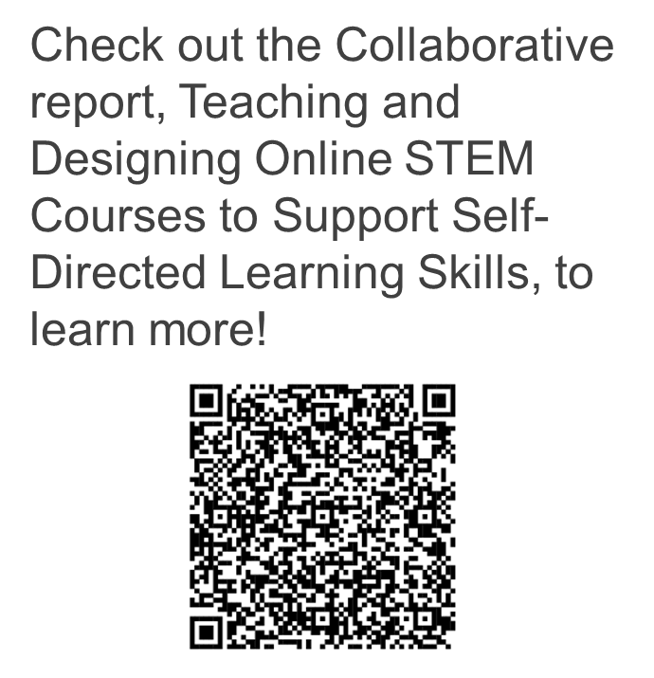

Framework for Self-Directed Learning (SDL)
Source: Yarnall et al., 2023.
Notes:
The collaborative developed this self-directed learning framework that draws on three aspects of how students manage their learning: motivation, metacognitive processes, and applied learning approaches that research has shown support effective self-directed learning.
The framework begins with students’ initial motivational mindsets, which shape their commitment to learning. That commitment then drives their metacognitive processes to plan, monitor, adjust, and reflect on their learning. Those metacognitive processes provide the structure and support for a series of applied learning activities that students can use to adaptively manage their learning. The resulting experience of academic success feeds positive emotions and refuels motivation, which starts the SDL cycle anew. ​
These SDL skills are distinct from, and an important complement to, the domain-specific problem-solving strategies that are typically taught in STEM courses and other disciplines.
https://postseccollab.org/teaching-and-designing-online-stem-courses-to-support-sdl-skills/

Slide 8

Reflection
What online learning challenges do your students experience that could benefit from SDL skill support?
Notes:
Before we dive deeper into these strategies, let’s pause for a reflection. What online learning challenges do your students experience that could benefit from SDL skill support? We invite you to raise your hand or share thoughts in chat

Slide 9
Self-Directed Learning (SDL) Instructional Model

Slide 10




Development process
Multiple rounds of research, refinement, and testing, including:
Foundational literature & qualitative research
Co-design with faculty
Multiple rounds of testing & refinement
Pilot study of complete model
Notes:
In addition to the collaboration, there were multiple rounds of research, refinement, and testing.
Foundational literature review and qualitative data to gather information about institutional practices and polices.
The next phase, completed in 2024, involved rapid studies with 24 instructors from four partner institutions who embedded at least one of the three SDL strategies into online courses.
The third phase, also completed in 2024, studied the feasibility of engaging instructors and students in using all three SDL strategies.
The final phase, conducted in 2025, studied the effects of all three SDL strategies in a sample of 25 course sections at five institutions.

Slide 11




SDL Instructional Model
Three evidence-based strategies to help college students manage their online learning better:
Use technology to support student-peer interaction and networking (SPIN) and promote help-seeking
Assign SDL videos to support sense of belonging, planning for learning, confidence, and self-efficacy through a growth mindset
Set up SDL prompts focused on help-seeking, task-planning, and reflection
Notes:
These partnerships and research activities results in the SDL Instructional Model, which offers college educators three evidence-based strategies to help college students manage their online learning better. These strategies tackle key challenges of online learning by helping students cultivate habits that are strongly related to student success, including developing a sense of belonging that builds social connections, planning time for coursework, reflecting on progress to develop confidence and self-efficacy, and learning how to seek help when needed. Faculty can weave these three strategies through their courses in an iterative, integrated way.
The first is student-peer interaction and networking or SPIN. SPIN has two parts. First, there is an introductory questionnaire to administer to students. Later in the course, there are collaborative peer-work assignments. The second activity is a series of 10-minute videos with a corresponding set of reflection questions for students to answer. These videos focus on sense of belonging, growth mindset, and time management. Finally, there is a series of prompts that can be administered throughout a course. There are three types of prompts: reflective prompts, an assessment wrapper around a major assessment or assignment, and a final reflection at the end of the course in the form of a letter to a future student. Students answer the prompt questions in short paragraphs.
Together, we refer to these strategies as the Instructional Model. Faculty can add the strategies to their course as:
Discussion board questions, as a stand-alone assignment, or as an extension/addition to an existing assignment.
Faculty can make the activities optional, graded (for course grade or participation), extra credit, or “gateway” assignments.

Slide 12
Learning theories underpinning the SDL strategies
Microlearning
Short learning activities with quick feedback
Often offered on digital platforms
Adult learning
Views learning as self-directed, experience-based, goal-oriented, relevant, and practical
Collegial, collaborative relationship between student and instructor
Primes and reminds students to apply skills within the course
Students are offered support to (a) build own learning management capacity and (b) develop confidence and knowledge to direct own learning — especially important when learning online
(Knowles, 1984; Merriam, 2001; Merriam & Caffarella, 1999; Morris, 2023)
Notes:
Some of the learning theories that serve as a basis for the SDL strategies include microlearning, or short learning activities that prime and remind students to apply certain skills.
The overall design of the Instructional Model is based on adult learning principles that focus on the student's confidence and knowledge to direct their own learning, and ways that the instructor can create an experience-based, goal-oriented, relevant, and practical environment.
(Knowles, 1984; Merriam, 2001; Merriam & Caffarella, 1999; Morris, 2023)

Slide 13
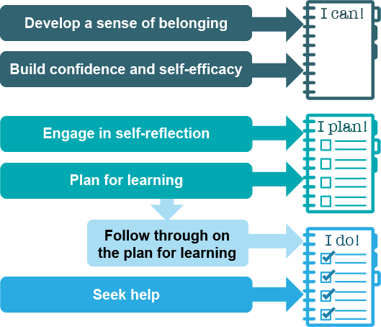
Targets five student skills
Notes:
The Instructional Model aims to build student capacity with 5 key skills that relate to the processes.
There are two "I can" skills aligned with motivation processes, what we call "I can," which provide the foundational emotions and beliefs that energize students’ approach to learning. :
Develop a sense of belonging. Students who experience belonging in a course feel connected to peers and faculty and feel accepted, respected, and valued.
Build confidence and self-efficacy as a college student. Students with self-efficacy feel they can overcome obstacles to achieve their goals; they exhibit a growth mindset.
Two skills aligned with metacognition process, or “I plan,” translate those emotions and beliefs into an action plan.
Engage in regular self-reflection around learning progress. Students who reflect assess what worked and what didn’t after completing a task and use this information to adjust their plans for the future.
Plan for learning. Students with planning skills anticipate the learning strategies they will need to meet their goals; they can estimate the time needed for tasks and lay out steps to meet deadlines. While creating the plan is related to metacognition, following through – and adjusting if needed – on the plan, is related to applied learning.
The final skill aligned with “I do” or applied learning, that put the learning plan into action
seeking help, which also includes finding resources, implementing and adjusting strategies. Students are more likely to take action when they see how it fits in their plan, and how additional resources, social support, or different study strategies will help them.

Slide 14
SDL Instructional Model guides
Course Implementation Guide
for faculty
Campus Resource Guide
for leaders & educational developers
SDL Instructional Model: An Overview
How to Implement the Instructional Model: A Pacing Guide
How to Integrate the Strategies
How to Measure Whether the Strategies Work
Using the Strategies in Your Course
Strategy Overview
Ready-to-Use Text
Adaptations and Customizations
Information for Leaders: Adopting the SDL Instructional Model
The Science Behind Self-Directed Learning
Resources for Educational Developers
Getting Started: An Introductory Workshop
Going Deeper: A Professional Learning Community
Staying in Touch: Additional Touchpoints for Faculty
Notes:
The SDL Instruction Model includes two guides containing multiple resources. The Course Implementation Guide is a step-by-step guide for faculty to integrate the instructional strategies into online courses. The guide features “copy and paste” text for any learning management system (LMS), as well as course integration tips and examples.
The Campus Resource Guide provides instructional leaders with information for adopting the Instructional Model on their campus, the theory and evidence in support of SDL skills, and a full suite of resources for professional developers to support faculty learning about the SDL Instructional Model.

Slide 15
How to implement the strategies in your course
Notes:
The purpose of this section is to guide faculty through implementation of the three strategies. All of this content is included in the guides.

Slide 16
Three strategies
SPIN
Build students’ sense of belonging in the course
SDL videos
Develop a sense of belonging​
SDL prompts
Promote help-seeking
Build confidence and self-efficacy
Encourage planning for learning
Encourage​ planning for learning
Engage in regular self-reflection
Promote help-seeking
Notes:
Now, let’s dive into the three strategies
Review which skills they promote.

Slide 17
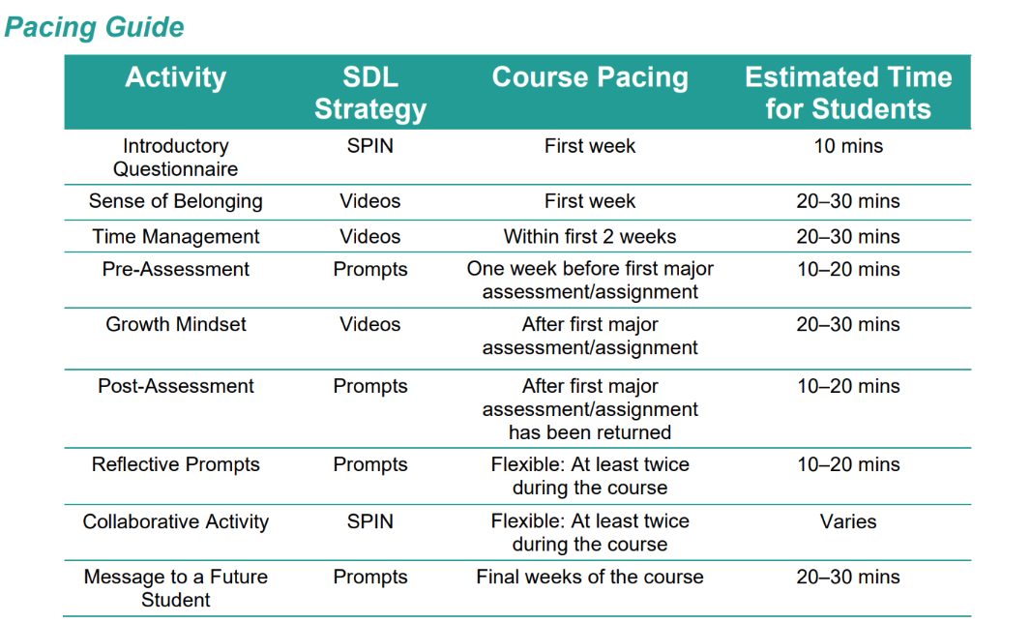
Pacing guide
Notes:
First, we have a pacing guide that provides a suggested ordering of the strategies and approximately how much time they take for students to complete.
These activities are best administered during certain parts of the course.
The SPIN questionnaire and the first two videos in the SDL series on sense of belonging and time management work well at the beginning of a course. This helps set the foundation around motivation to support students in building a sense of belonging.
During the course, the growth mindset video sets the stage for being resilient in the face of first challenge – perhaps the first major assessment – building confidence and self-efficacy.
The reflective prompts and the assessment wrapper engage students in metacognitively evaluating their performance and considering different learning strategies to improve their performance.
SPIN collaborative activities reinforce the habits of metacognitive progress – checking and adjusting learning strategies – and the applied learning skills of following through on selected learning strategies and seeking help from peers.
The final message to a future student serves as a culminating activity, supports motivation, specifically growth mindset, for both the students writing the message and receiving it.
However, you have some flexibility based on the context of your course (for example, add/drop periods). The goal is to have all your students exposed to the strategies. ​The model has been implemented in 4-week, 5-week, and 8-week courses, and other course durations – faculty can adjust based on their course length. ​

Slide 18
Example activities
Collaborative activities
Introductory questionnaire
Administer non-content questionnaire about themselves
Share aggregated results with the class to foster connections
Provide a summative review of the peer-work experiences or group activities
Share a collaboration reflection tool
Video tutorials
Learn time management strategies
Prompts to schedule study time
Ready-to-use questions, prompts, and example collaborative activities.
Notes:
The introductory questionnaire asks students to share nonacademic information to help them get to know one another better, find shared experiences and connections, and promote a course atmosphere where students can “bring their full selves” to class. The Course Implementation Guide includes a bank of ready-to-use questions such as: What are your hobbies, pastimes, or activities that bring you the most joy? What time of day do you usually do schoolwork? After students have completed the survey, faculty can summarize common interests or spotlight the wide range of special talents in the class. Students can comment and react to what they learned about their classmates on a discussion board or in a synchronous meeting to build community among students. The questionnaire data can also be used to inform other instructional activities, including creating collaborative groups.
Faculty assign two collaborative activities that provide students an opportunity to work with peers on a meaningful shared academic task relevant to the course content. Consider using responses from the introductory questionnaire to form groups of students with common interests.
To set expectations, faculty share a collaboration reflection tool that students review before the activity and complete after the activity. Students also complete a reflection after the activities. The Course Implementation Guide provides several examples of asynchronous and synchronous collaborative activities.
What makes SPIN different from the group work I already assign?
SPIN includes a collaboration reflection tool that students will view before they begin working together and complete after the collaborative work is over.

Slide 19
Online collaboration challenges: Best practices
Incentivize participation
Group students intentionally
Explain the purpose of working in groups
Support relationship-building
Assign effective collaborative activities, with clear roles for each student
Share best practices for team meetings
Provide ongoing support
Notes:
Challenges of collaborative work include low participation, student skepticism, and uneven learning outcomes. In online courses, these challenges intensify, as many students may feel disconnected from peers and may be reluctant to engage in real-time collaboration. We have included suggestions for how to design the collaborative activities to promote engagement.
Students do not engage constructively with the collaborative activities.
Incentivize participation.
Group students intentionally.
Students prefer to work individually than in groups.
Explain the purpose of working in groups.
Students feel uncomfortable participating in their groups
Support relationship-building.
Students are uncertain what they can do to support their group success.
Assign effective collaborative activities, with clear roles for each student.
Students experience collaboration inefficiency and conflict when working in groups.
Share best practices for team meetings.
Students feel disconnected from their instructors when participating in peer work.
Provide ongoing support.

Slide 20
Example prompts
SDL prompts | Timing
Reflective prompts: three sample questions Excerpt: What assignments and other coursework do you need to complete this week for this class? Which concepts from this class do you feel you mastered this week? | Twice during course
Pre-post assessment prompts (“wrapper”) Excerpt: (Pre) What challenges or barriers do you anticipate you might encounter preparing for this assessment and how might you overcome them? (Post) Did you stick to the plan you made for yourself? | Once before and after an assignment
Ready-to-use text for all prompts
Notes:
The reflective prompts are real-time, short-answer questions embedded in course. Students answer them in short paragraphs either in discussion post or assignment in the LMS. They reinforce the habits of reviewing assignments ahead of time and planning to gather the right learning resources, both from within the course and without, to support one’s success. These prompts can be used 2 or 3 times throughout the course.

Slide 21
SDL prompts (continued)
SDL prompts | Timing
The message to a future student invites students to reflect on their course performance and can be assigned as a written reflection or a video recording. Excerpt: What did you wish you knew going into the course? What did you learn about yourself as a learner? | Once at end of course
Ready-to-use text for all prompts
Notes:
The reflective prompts are real-time, short-answer questions embedded in course. Students answer them in short paragraphs either in discussion post or assignment in the LMS. They reinforce the habits of reviewing assignments ahead of time and planning to gather the right learning resources, both from within the course and without, to support one’s success. These prompts can be used 2 or 3 times throughout the course.

Slide 22
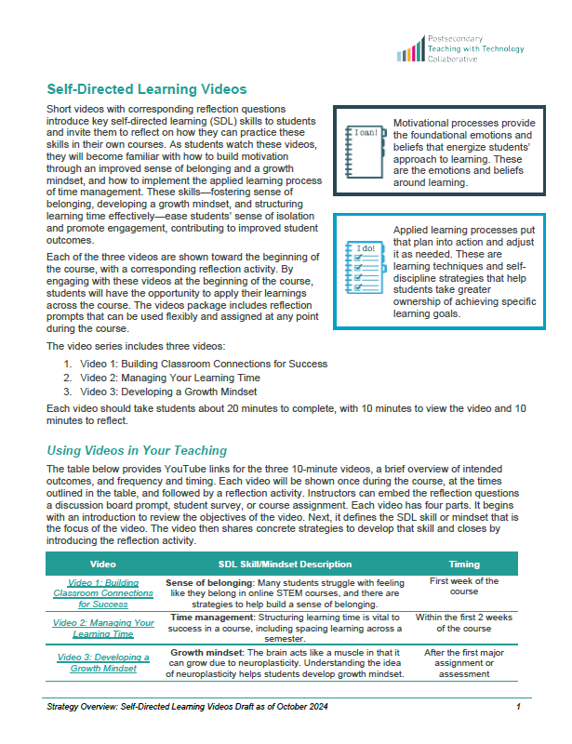
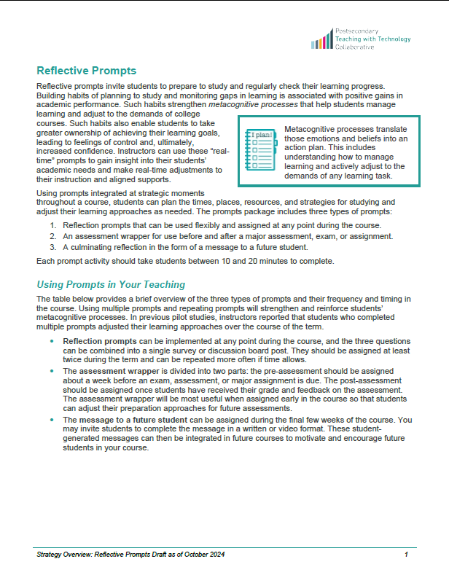
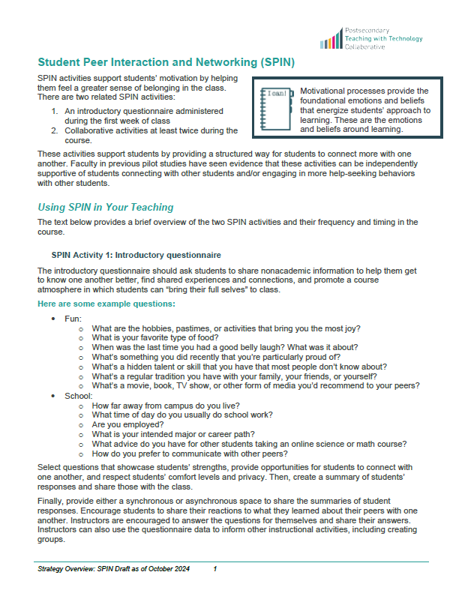
Resources and guidance
Visit the event page for today's session at https://postseccollab.org/events/ to access draft versions of the instructional strategies and implementation guidance.
Videos | Prompts | SPIN
Notes:
You can visit the event page for today’s webinar on our website at postseccollab.org/events to access the current versions of the instructional strategies and implementation guidance.

Slide 23
Initial research findings

Slide 24
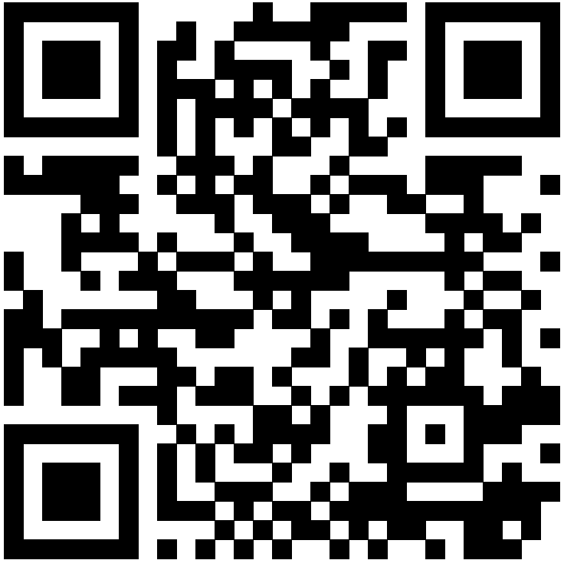
Research study findings
Students found the strategies useful and changed their learning strategies.
Faculty found the strategies easy to integrate and gained helpful insights into students’ learning needs.
We found positive, statistically significant impacts on applied learning and metacognitive outcomes.
Analyses indicate a 78% probability that the strategies had a positive effect on grades.
Notes:
Facilitator reviews initial findings from the pilot. Key talking points include:
Students said that both reflective prompts and short videos helped them assess their weekly workload and schedule time for studying. Students in classes implementing at least one SDL strategy reported using more applied learning strategies and reflecting on how to use them.
Most instructors found the strategies easy to integrate into online courses and provided helpful insights into students’ learning needs. Some adjusted their instruction based on these insights.
We found positive, statistically significant impacts on applied learning and metacognitive outcomes.
Impacts on end-of-course grades were insignificant, but Bayesian analyses indicate a 78% probability that the strategies had a positive effect on grades.
There is no evidence of differences in effectiveness across the different strategies, student populations, or courses.

Slide 25
Findings from Survey
Being in a class implementing 1+ strategies positively impacted
Students’ use of more learning strategies (drawing diagrams, revising lecture notes, and revisiting practice problems)
Whether students evaluated their learning strategies
This study found the effectiveness of the strategies were consistent across student populations and across different courses
Outcome Domain​s | Outcome​ (* = Admin. Data)​ | Impact Estimate (SD)​ | p-Value​ | Prob Positive Impact
Achievement​ | End-of-course grade* | 0.05 | 0.450 | 78
Applied learning​ strategy outcomes | Learning strategies inventory​ | 0.16 | 0.019 | 83
 | Help seeking​ | 0.08 | 0.314 | 72
 | Time management​ | 0.01 | 0.916 | 65
Metacognitive outcomes | Comprehension monitoring​ | 0.08 | 0.283 | 81
 | Debugging strategies​ | 0.06 | 0.528 | 81
 | Evaluation​ | 0.21 | 0.006 | 98
 | Goal-setting​ | -0.02 | 0.762 | 65
Motivational​ outcomes | Self-efficacy​ | -0.10 | 0.188 | 19
 | Sense of belonging​ | -0.15 | 0.121 | 15
 | Growth mindset​ | -0.07 | 0.341 | 34
Notes:
In talking points share some practical examples of what the survey items from the scales reflect

Slide 26
Insights from instructors
Engagement
Time and Value
Adjustments and Adaptations
Data
Thoughtful integration into existing activities
Incentives
Variation of pacing
Worth their time
Informed their insight of student content-related understanding
Less sure if videos had an impact
Continued participation led to comfort to make adjustments
Adjustments often included change to pacing and focus of reflection questions
Attuned to course grades, rates of withdrawal and completion
Identified student learning needs

Slide 27

Insights from students
“Learning about other people and what they experience, and finding myself in that same boat.”
- Student experiencing Prompts + Video
“That actually helped me think back on what I learned.”
“What didn't you understand so well this week? … When I got asked that question I realized, ‘Oh, I really need to study this, because I didn't really understand it that well this week.’”
- Students experiencing Prompts
“I started a WhatsApp group for the class, only I think [with] 8 or so people. I was inspired by one of the videos to start the group.”
- Student experiencing Video
Notes:
Krystal
Across 3 terms, we interviewed 25 students that engaged with one or more instructional strategy. We identified a few themes in student interviews where students reflected on:
Motivation: One aspect of sense belonging in online courses suggests that students may feel isolated or having experiences that no other has experienced. Many students found the video storylines to be very relatable to their own experiences as demonstrated in the first quote. (Spring 2023 – Student #3)
Metacognition: Students enter college with their own approaches to learning that may be more effective in some courses than others. By engaging in prompts strategy, many students talked about the questions to check for their understanding to make them reflect on their understanding of the concepts or think about a plan to better understand. (Spring 2023 – Student #2, Fall 2023 – Student #1)
Applied learning: Some students changed or improved their learning strategy approach. (Spring 2023 – Student, Spring 2023 – Student 6)

Slide 28
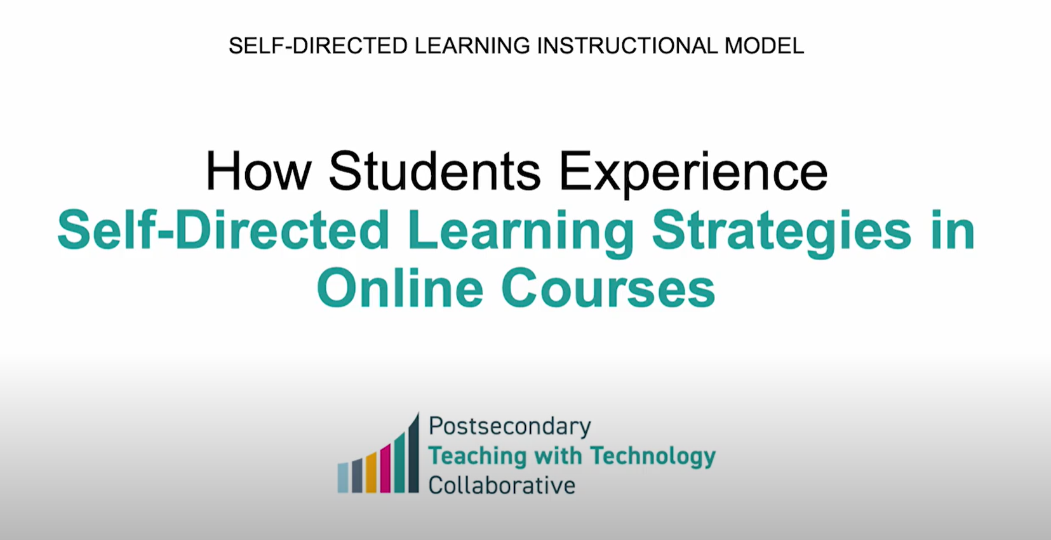
Students have responded positively to the SDL stratgies
Student video (long version)
Notes:
Student perspective
https://www.youtube.com/watch?v=RgUwrv0oQ4s

Slide 29
Discussion

Slide 30






Thank you
Visit us at https://postseccollab.org/
Follow us on X: @PostsecCollab
Interested in learning more?
Fill out this form!
The research reported here was supported by the Institute of Education Sciences, U.S. Department of Education, through Grant R305C210003 to SRI International. The opinions expressed are those of the authors and do not represent views of the Institute or the U.S. Department of Education.
Notes:
Thank you for your time and interest! Please feel free to reach out with specific questions.

